Slide 1
Simple and scalable modelling of elective waiting lists using R
Dr Richard Wood
Head of Modelling and Analytics, BNSSG ICB
Visiting Senior Research Fellow, University of Bath

Slide 2
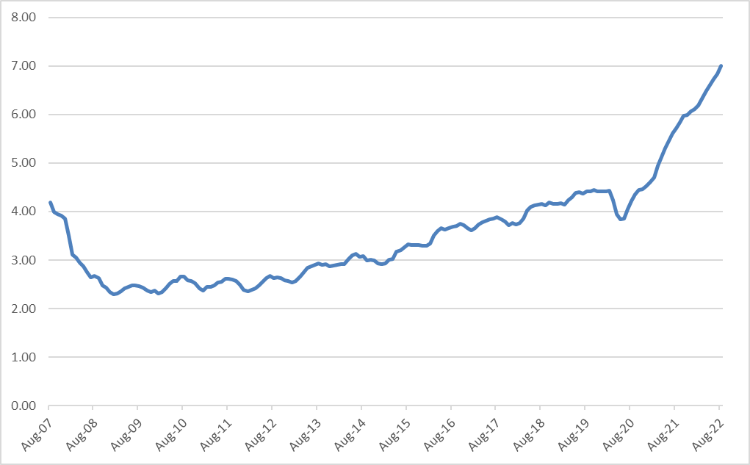
England waiting list size (millions)
August 2022 – hits 7m
COVID-19 still restricting elective treatment capacity
Initial effect of pandemic (reduced capacity but lower demand = drop)

Slide 3
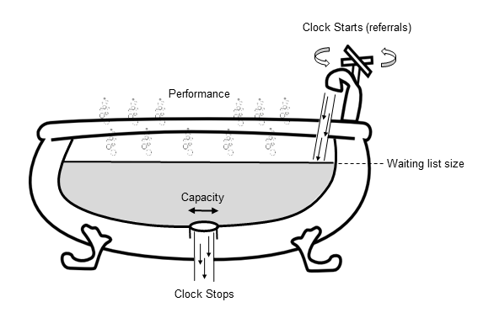
Bathtub analogy of waiting list dynamics
GP referrals
Performance
(18wk RTT %)
Waiting list size
Capacity
Treatments

Slide 4
We can model this with Discrete Time Simulation
Loop over replications
For (run in 1 to 100000) {
For (day in -200 to 365) {
Clock starts
sample # referrals from Poisson distribution
add these to bottom of waiting list
Clock stops
set # activity from fixed capacity
remove these from top of waiting list
Performance measures
save: waiting list size
save: proportion waiting under 18wks
update waiting times
}
}
aggregate results across runs
Loop over time-steps
Simulate referrals and treatments on that day
Summary measures

Slide 5


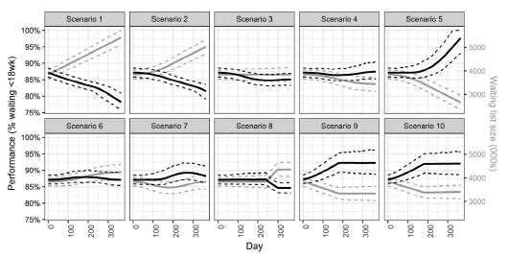
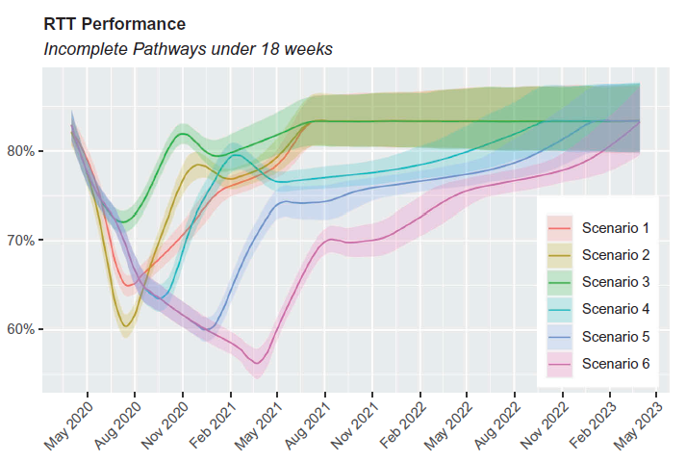
Outputs can support strategic decision making
both… pre COVID-19 …and… at the start of the pandemic

Slide 6
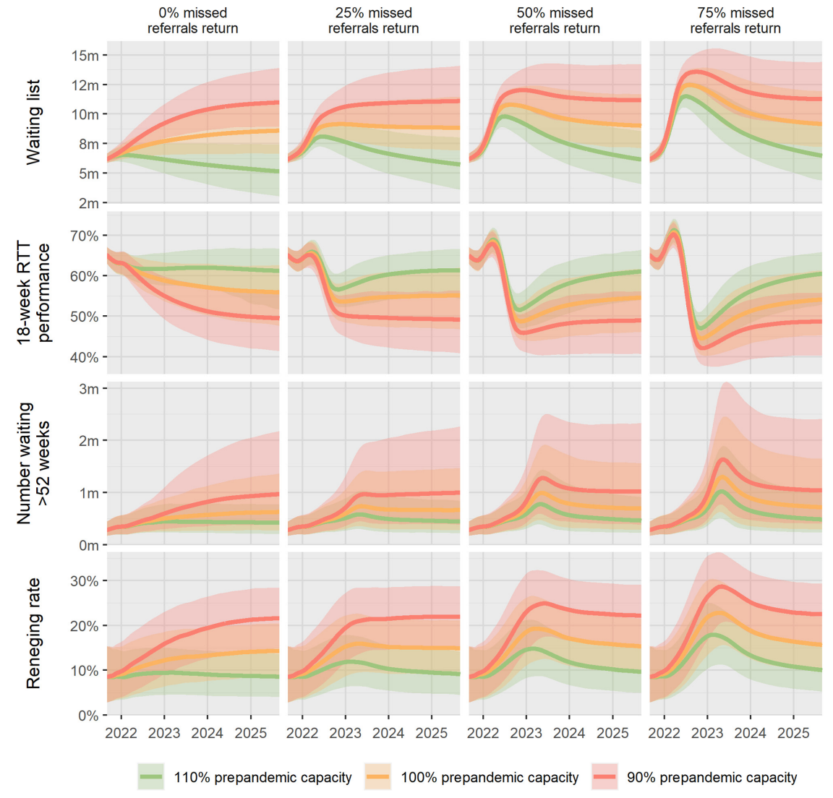

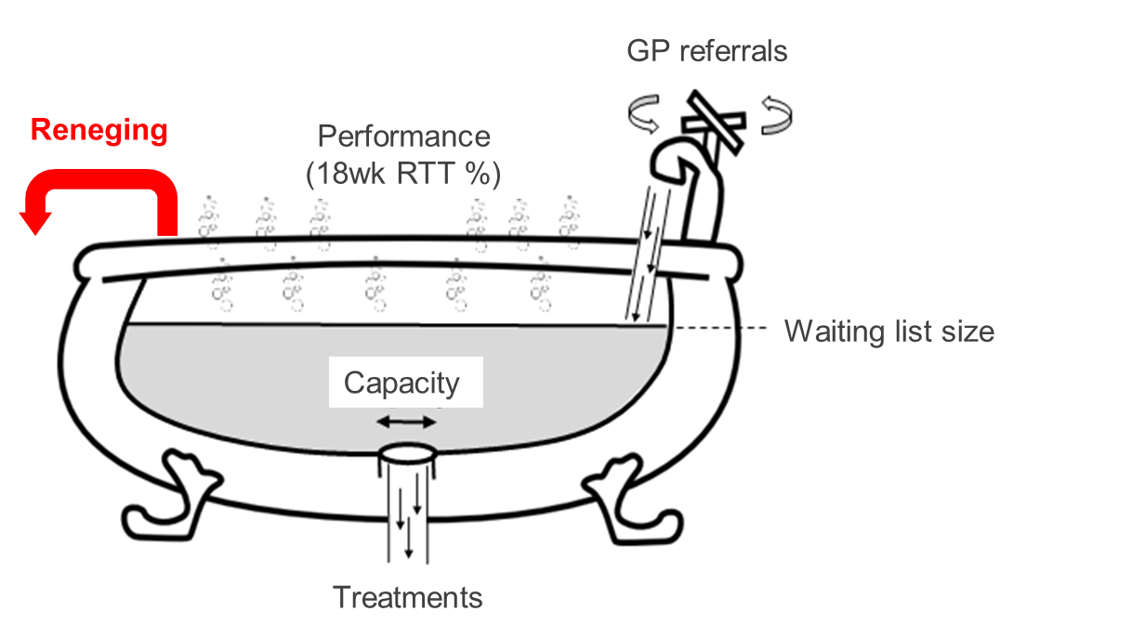
And pandemic recovery
With waiting lists so large, it is essential to consider the increased risk of patients ‘reneging’ (leaving the waiting list before treatment)

Slide 7
But…
It is not simple to calibrate the DTS simulation model.
Which means we can only really use it for one instance at a time.
E.g. at the aggregated-specialty England level here (also at BNSSG level too).
It is therefore not scalable.
A scalable solution would benefit from being able to be applied en masse:
For all hospital trusts.
For all specialties.
On a monthly basis.
The aim is therefore to create a simple and scalable model for waiting lists.

Slide 8
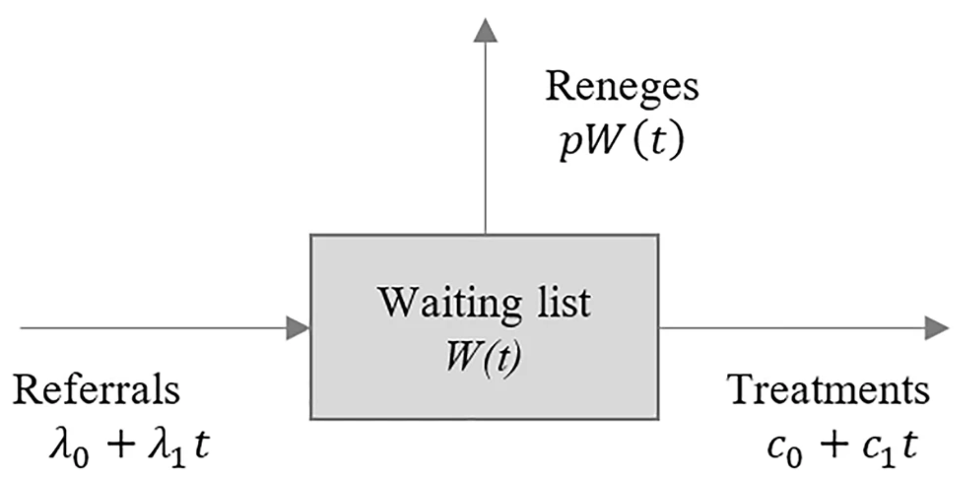
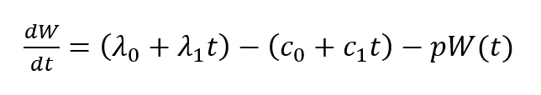
Simplified waiting list dynamics
Proportion reneging
Current referral rate
Referral rate growth
Current capacity
Capacity growth
Must solve:

Slide 9
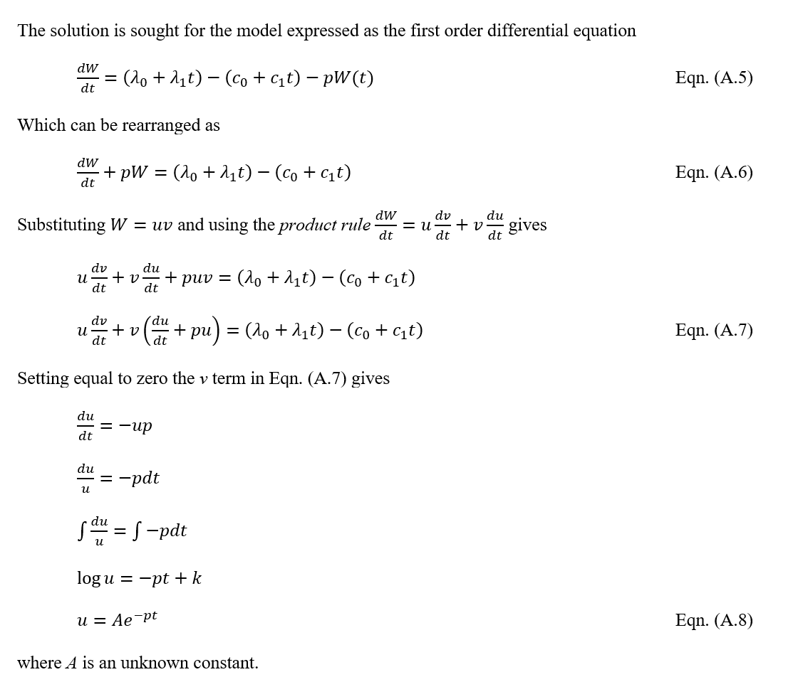
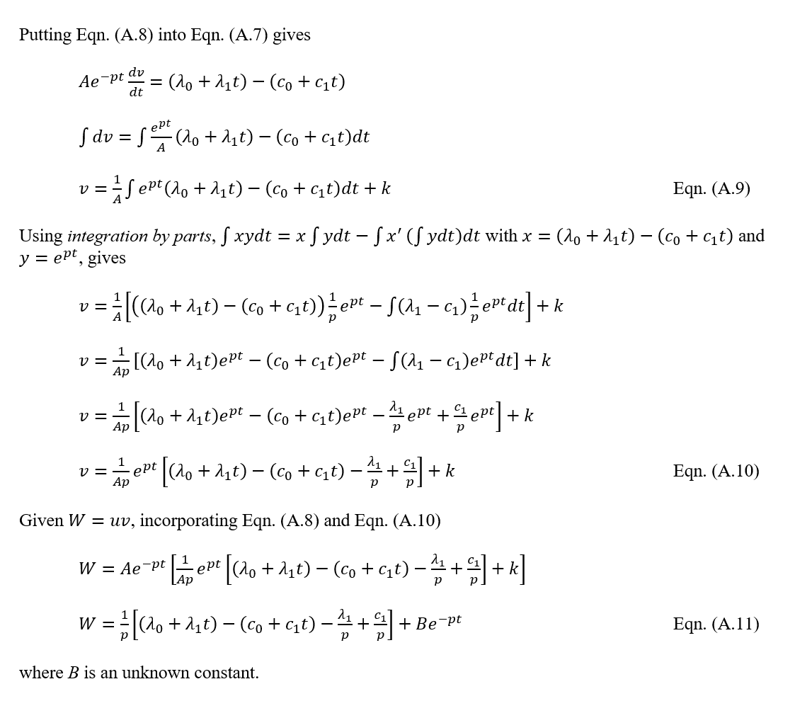
Solution

Slide 10
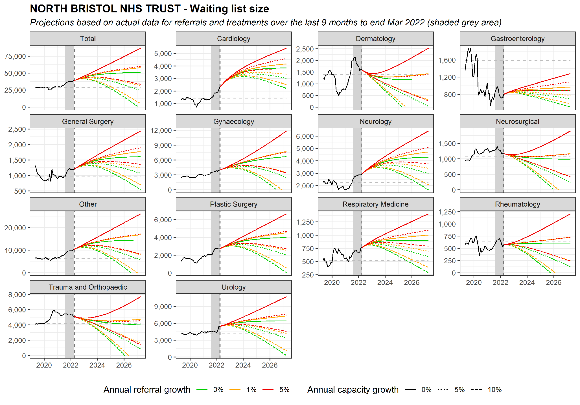
Example application – a hospital in BNSSG
The model is fitted to recent data (grey areas).
It projects future wait list size at specialty level.
These are based upon:
0, 1, 5% referral growth.
0, 5, 10% capacity growth.
(both are variable in code).

Slide 11
Utility
Provides a ‘do nothing’ assessment of future wait list size, assuming:
No changes to capacity and according to different (unknown) demand rates.
Modelling of additional capacity allows consideration of the resources required to recover waiting lists within given timescales.
Projections useful for long-term planning in helping to understand which specialties could be prioritised for additional capacity.
Analysis is being complemented with estimates of the additional healthcare activity consumed while waiting for treatment (separate work).
This helps identify particular specialties which could be targeted to prevent additional pressures.

Slide 12
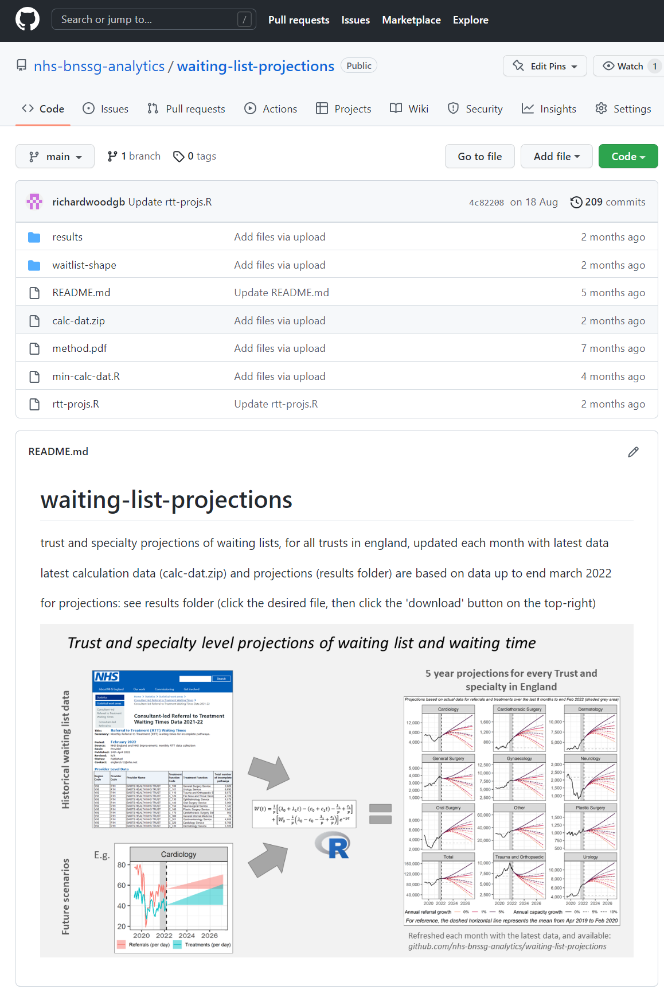
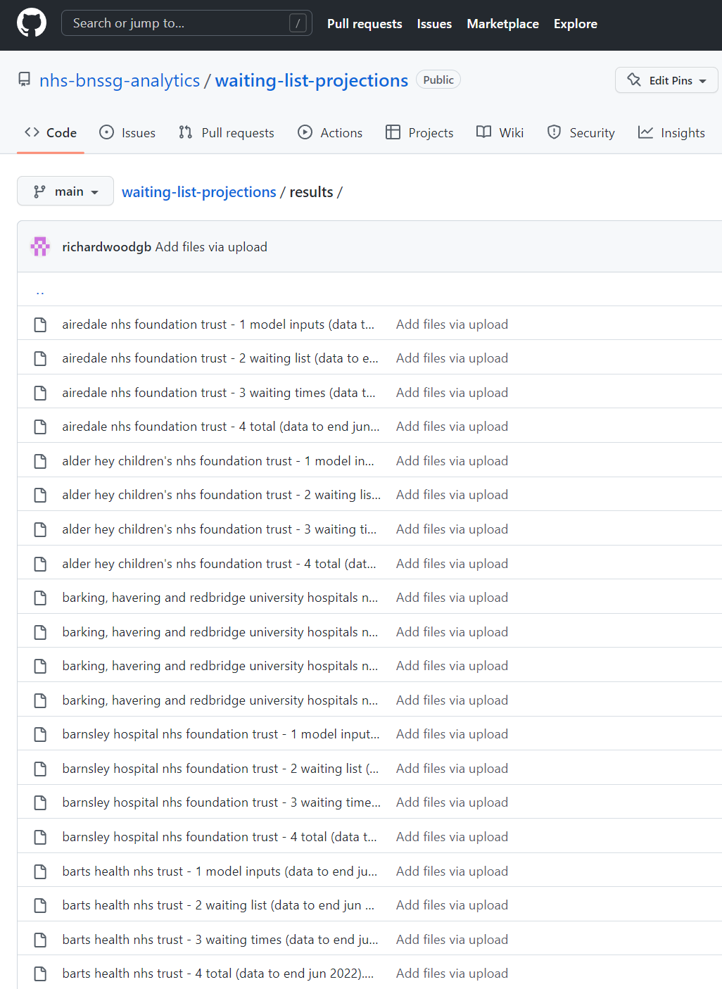
GitHub repository
github.com/nhs-bnssg-analytics/waiting-list-projections
Contains projections:
For all hospital trusts.
For all specialties.
Updated on a monthly basis.

Slide 13
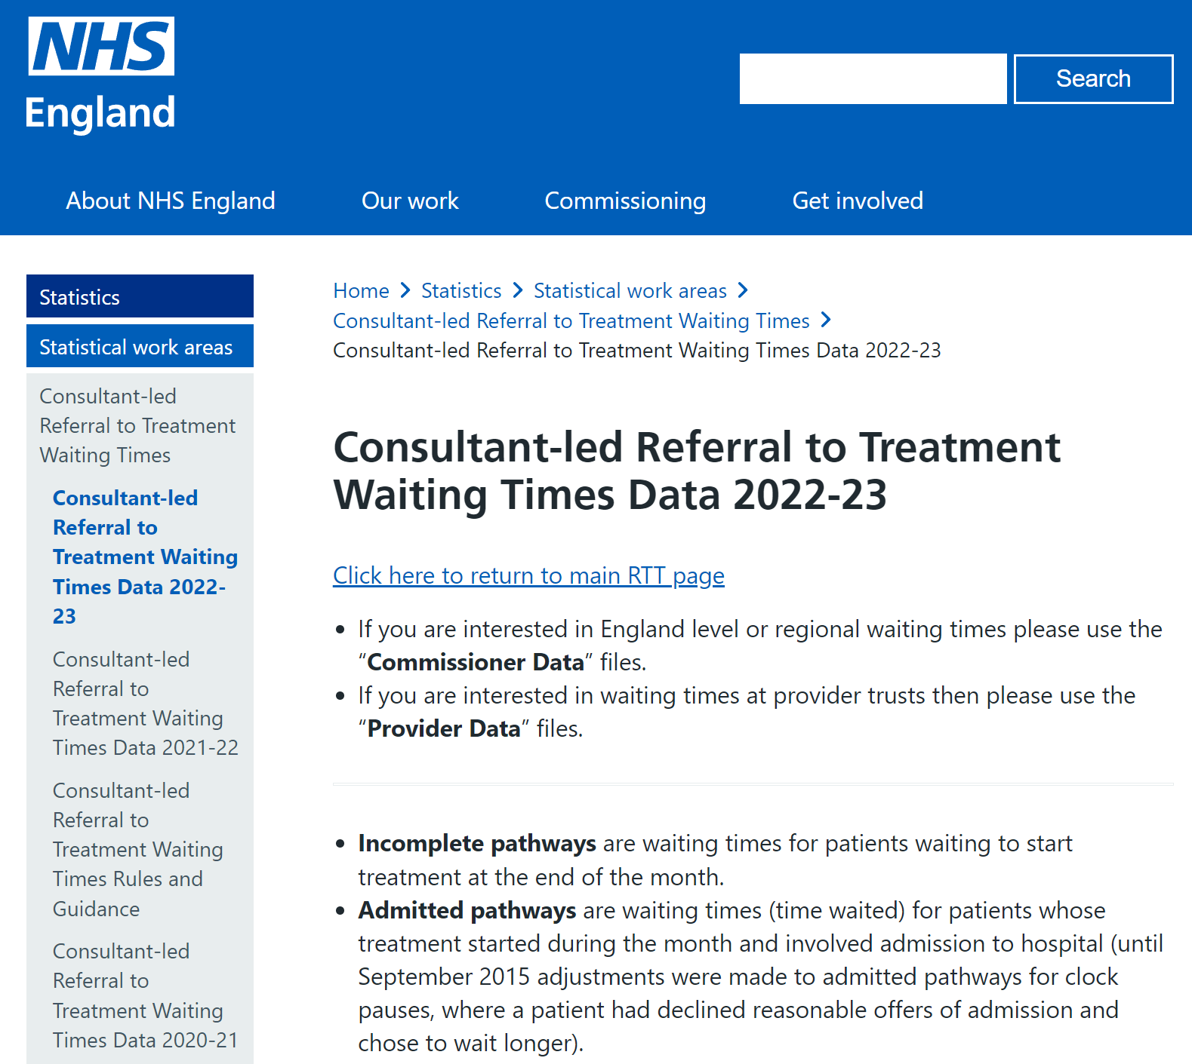
Data scraper
Credit: Dr Nick Howlett
All input data is publicly available.
It is updated on a monthly basis.
We have developed an automated data scraper which each month:
Pulls the latest data.
Formats it ready for modelling.

Slide 14
Waiting list shape
Credit: Dr Nick Howlett
The formatted data is also used to create animated gifs of waiting list shape over time.
These are also produced for each trust and specialty in England.
They are updated each month and available at the GitHub page.

Slide 15

richard.wood16@nhs.net
github.com/nhs-bnssg-analytics/waiting-list-projections
Wood, R. M. (2021). Unravelling the dynamics of referral-to-treatment in the NHS. Health Systems, 10(2), 131-137.
Wood, R. M. (2022). Modelling the impact of COVID-19 on elective waiting times. Journal of Simulation, 16(1), 101-109.
Howlett, N. C., & Wood, R. M. (2022). Modeling the Recovery of Elective Waiting Lists Following COVID-19: Scenario Projections for England. Value in Health.
@BNSSGAnalytics

